Slide 1

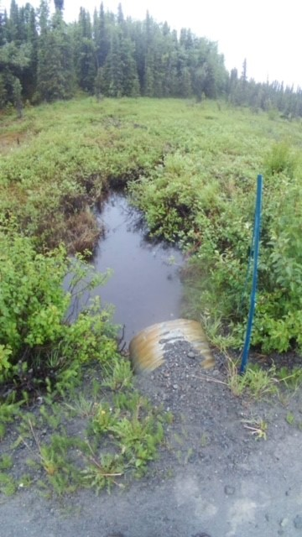
Phytoremediation at road-stream crossings
Lucas Byker
USFWS Habitat Restoration

Slide 2
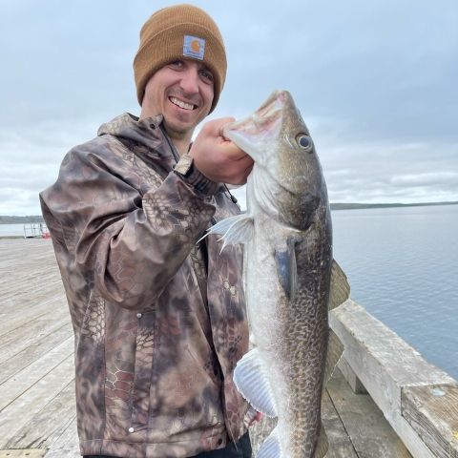
Introduction
Paratrooper with 10th Special Forces Group (Fort Carson) and 4/25 Infantry Division (JBER)
USDA Wildlife Services technician (Anchorage and JBER)
Crab Fishery Observer (Dutch Harbor)
ADF&G Habitat Biologist (Soldotna)
Kenai Peninsula Borough River Center Manager (Soldotna)
USACE Regulatory Biologist (Anchorage)
USFWS Habitat Restoration Biologist (Mat-Su and Kodiak)

Slide 3
Road Runoff
Impacts to Fish
Where does it come from?
Large concentrations of contaminants can cause large-scale mortality events.
Smaller concentrations can cause reduced fecundity, reduced respiration, and increased juvenile mortality.
Sediment clogs gills, fills and destroys spawning gravel, and reduces visibility for foraging
Climate Change*
Vehicle traffic produces heavy metals and chemicals from tires, brake pads, and exhaust.
Sediment from roads and road shoulders can be introduced into waterways through erosion.

Slide 4
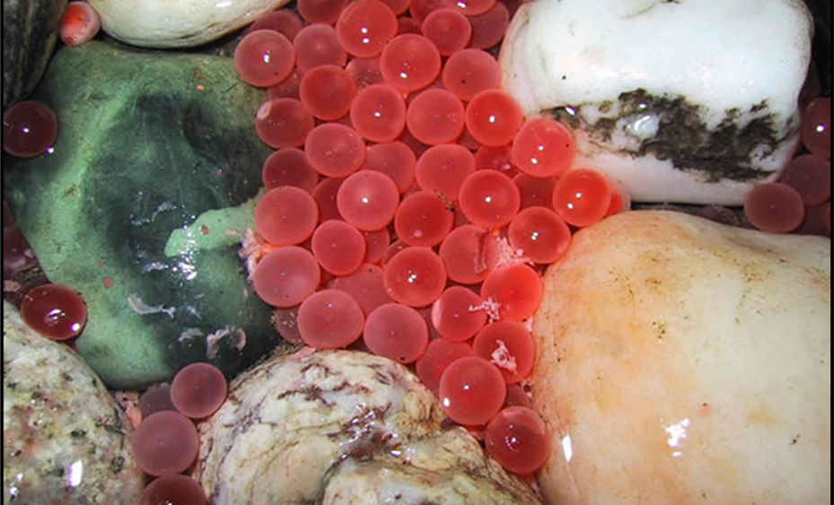
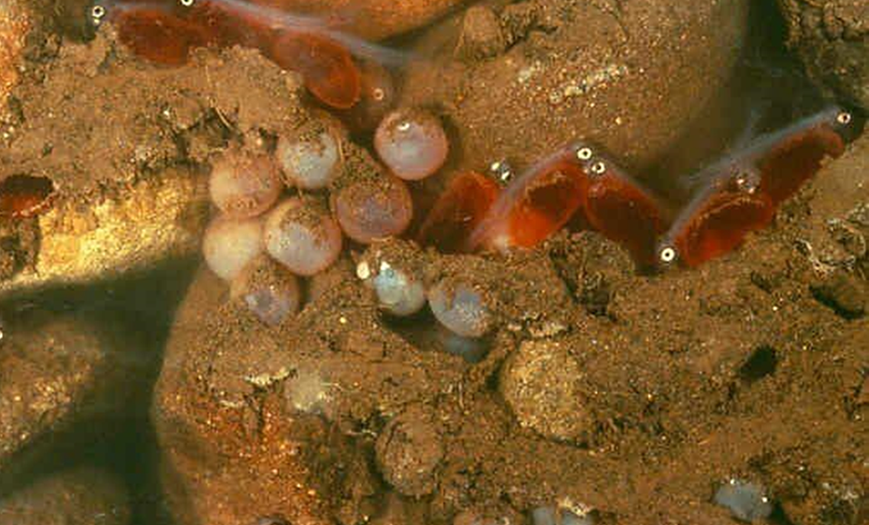

Slide 5
Phytoremediation?
Phytoremediation
Bioremediation
“The use of plants for containment, degradation or extraction of xenobiotics from water or soil substrates.”
“The use of either naturally occurring or deliberately introduced microorganisms or other forms of life to consume and break down environmental pollutants, in order to clean up a polluted site.”

Slide 6
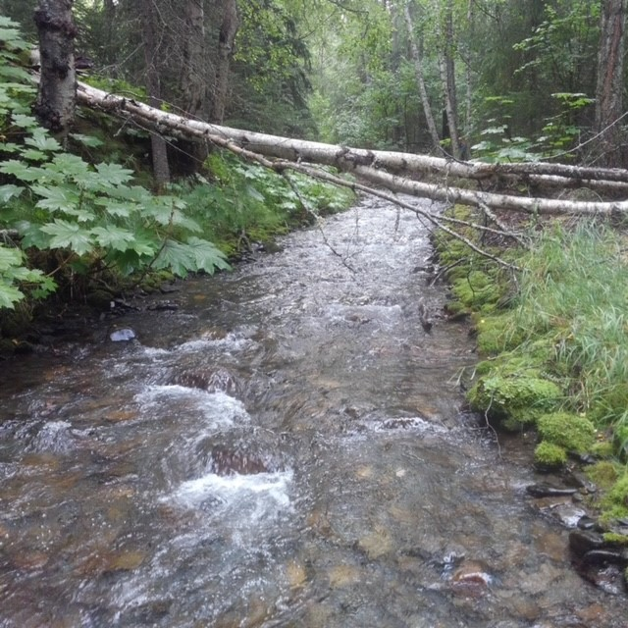
How Does it Work?
Extraction
Detoxification
Some plants, along with the microbes associated with their root systems, are able to remove heavy metals and other contaminants from surface water, if the water is able to soak into the soil.
Surface runoff which has the chance to soak into the soil is cleaned in multiple ways:
Settling of the contaminants by reducing flow velocity.
Dissolved organic carbon attaching to heavy metals, reducing their bioavailability.
Filtering of the water through increasingly finer soils.

Slide 7
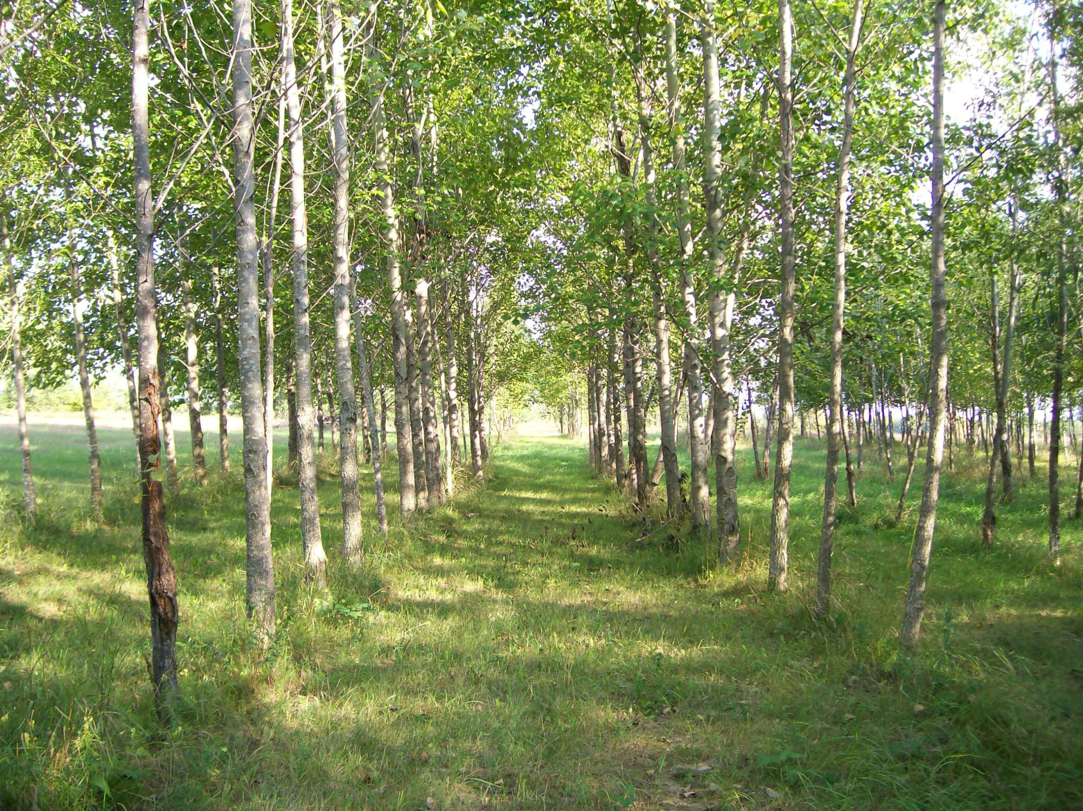
Cabin Creek Oil Refinery
Aspen phytoremediation was utilized to clean up petroleum contamination in both soils and groundwater.
Depending on the chemical, reduction in chemical was reduced by up to 90% in lower soil horizons, and up to 84% in ground water.
Data was gathered over the course of a decade.

Slide 8
Seattle Urbanized Streams
Bad News
Good News!
A 2022 study found that juvenile coho salmon exposed to 24 hours of untreated storm runoff experienced a 100% mortality rate.
Mortality rates were significantly lower in other species, with a 0% mortality rate amongst sockeye salmon.
All species did not recover when transferred to clean water.
In this case, the causal agent was a chemical known as 6PPD, which is used in the manufacture of tires.
Dilution of the stormwater only reduced the mortality rate by 10% in juvenile Coho salmon.
A 2015 study examining the ability of bioretention columns in reducing the toxicity of stormwater runoff found that storm water filtered through bioretention columns was significantly less lethal to Daphnia and juvenile coho salmon.

Slide 9
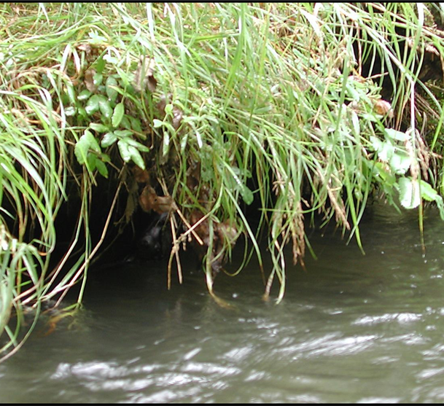
What Alaskan Plants?

Slide 10
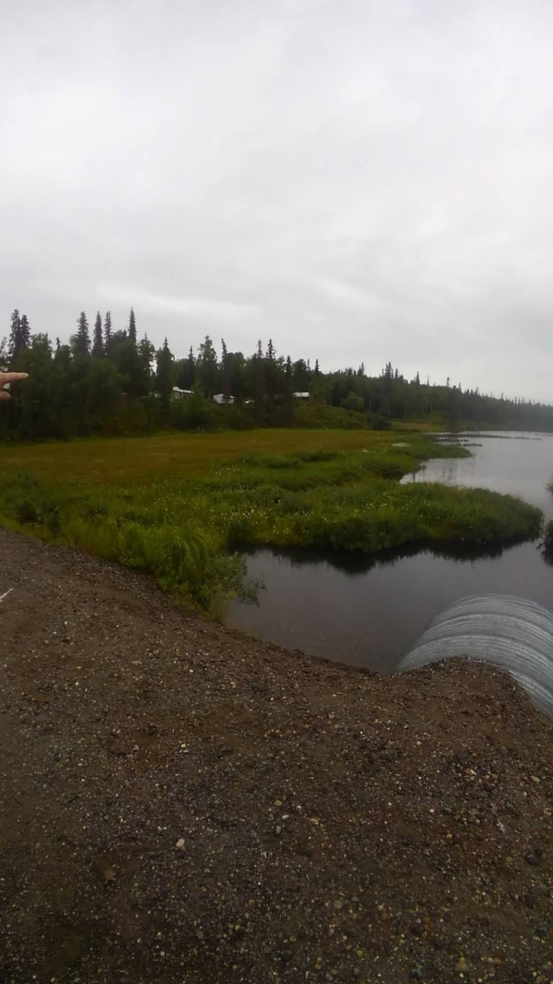
Implementation
Restoring Native vegetation
Design implementations to divert flows to floodplain or adjacent wetlands
Increase use of vegetation on road shoulders that has longevity and deep roots
Increase knowledge on restoration of wetlands at crossing sites

Slide 11
Works Cited
El-Gendy AS, Svingos S, Brice D, Garretson JH, Schnoor J. Assessments of the efficacy of a long-term application of a phytoremediation system using hybrid poplar trees at former oil tank farm sites. Water Environ Res. 2009 May;81(5):486-98. doi: 10.2175/106143008x357011. PMID: 19472940.
Chow, Michelle I., Jessica I. Lundin, Chelsea J. Mitchell, Jay W. Davis, Graham Young, Nathaniel L. Scholz, and Jenifer K. McIntyre. 2019. “An urban stormwater runoff mortality syndrome in juvenile coho salmon.” Aquatic Toxicology 214 (September 2019): Article 105231: 10 p.
J.K. McIntyre a,⇑, J.W. Davis b, C. Hinman a, K.H. Macneale c, B.F. Anulacion c, N.L. Scholz c, J.D. Stark, 2014. “Soil bioretention protects juvenile salmon and their prey from the toxic impacts or urban stormwater runoff.” Chemosphere, (January 2015) Article
Contact Information: lucas_byker@fws.gov

