Slide 1
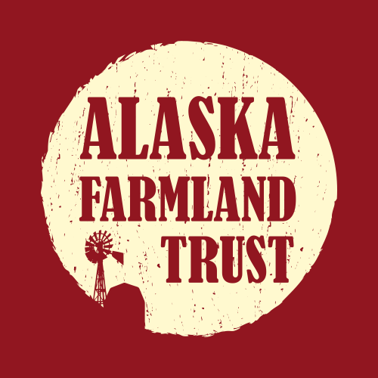
Farmland Conservation: Interactions to Improve Salmon Habitat

Slide 2
Alaska Farmland Trust
Envisions a future with thriving local food markets that will give Alaskans access to fresh, healthy food, and keep our farmers farming

Slide 3
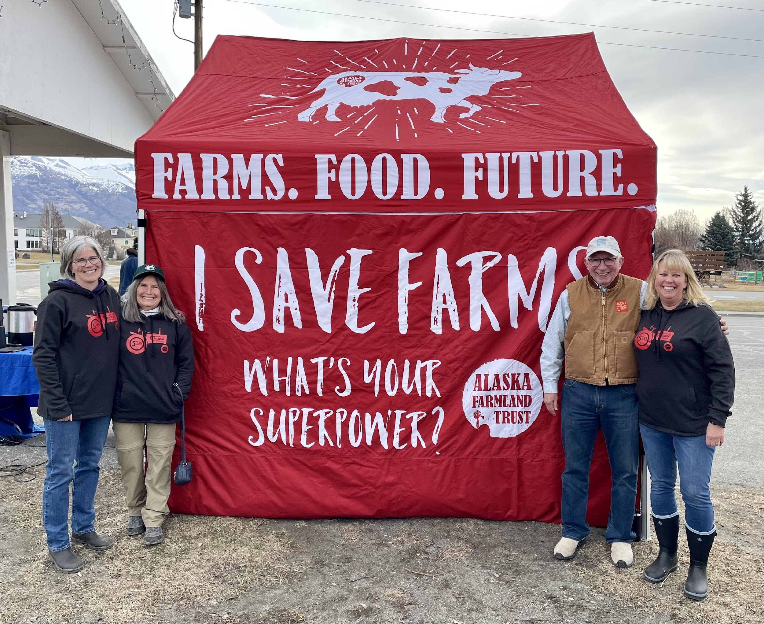

Slide 4




WHY WE SHOULD CARE ABOUT INCREASING OUR FOOD PRODUCTION: ADDRESSING FOOD SECURITY
One in five Alaskans is considered food insecure. Access to affordable, healthy foods is a challenge for many.
Thankfully, farms still exist to provide reasonably priced, nutritious and fresh vegetables.
Notes:
One in five Alaskans is considered food insecure. Access to affordable, healthy foods is a challenge for many. Thankfully, farms still exist to provide reasonably priced, nutritious and fresh vegetables. Fresh foods are nutritional foods. They last longer on shelves and in root cellars, are more easily accessible in remote communities and don’t rely on an international shipping system. By growing farms, we strengthen the health of our community.

Slide 5
Farms in the Mat Su Borough are responsible for over ½ of the States agricultural production.
The MSB has ~16% of the State’s population and yet in 2020 we built 43% of the new homes in the State

Slide 6
What is a
Conservation Easement?
A conservation easement is a voluntary legal agreement between a landowner and a land trust that permanently limits uses of the land in order to protect its conservation values.
Landowners retain many of their rights, including the right to own and use the land, sell it and pass it on to their heirs.

Slide 7
What is an AGRICULTURAL
Conservation Easement?
A voluntary legal agreement between a landowner and a land trust that permanently limits uses of the land in order to protect its agricultural values and requires continued agricultural use of the property.
Landowners retain many of their rights, including the right to own and use the land, sell it and pass it on to their heirs.

Slide 8
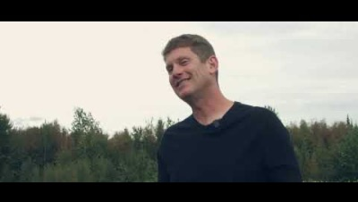
Protecting Agriculture improves salmon habitat

Slide 9
381 ACRES of Mat-Su Farmland Permanently Protected
  Closing on ~90 acres in early 2023,
  Currently working on 2 properties on the Spring System, one which borders the Matanuska River
  Initial phases of a property in Soldotna, with a salmon stream that runs through the fields
Provide facilitation for the UAF Experimental farm gravel extraction project

Slide 10
Questions?
(907) 390-9084
amyoconnor@akfarmland.com
www.akfarmland.com

